Slide 1
DR.SONAL MISHRA
Bacterial Internal Structures

Slide 2
Bacterial Internal Structures
Cell cytoplasm:
  dense gelatinous solution of sugars, amino acids, and salts
  70-80% water
    serves as solvent for materials used in all cell functions
2

Slide 3
Bacterial Internal Structures
Chromosome
  single, circular, double-stranded DNA molecule that contains all the genetic information required by a cell
  DNA is tightly coiled around a protein, aggregated in a dense area called the nucleoid.
3

Slide 4
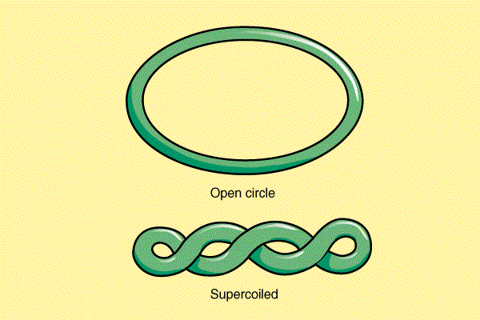
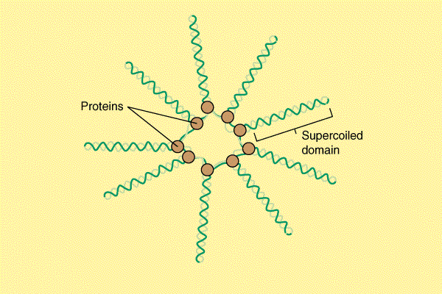
The bacterial chromosome and supercoiling

Slide 5
Bacterial Internal Structures
Plasmids
  small circular, double-stranded DNA
  free or integrated into the chromosome
  duplicated and passed on to offspring
  not essential to bacterial growth and metabolism
  may encode antibiotic resistance, tolerance to toxic metals, enzymes and toxins
  used in genetic engineering- readily manipulated and transferred from cell to cell
5

Slide 6
Bacterial Internal Structures
Ribosomes (70 S)
  made of 60% ribosomal RNA and 40% protein
  consist of two subunits: large and small
  procaryotic differ from eucaryotic ribosomes in size and number of proteins
  site of protein synthesis
  present in all cells
6

Slide 7
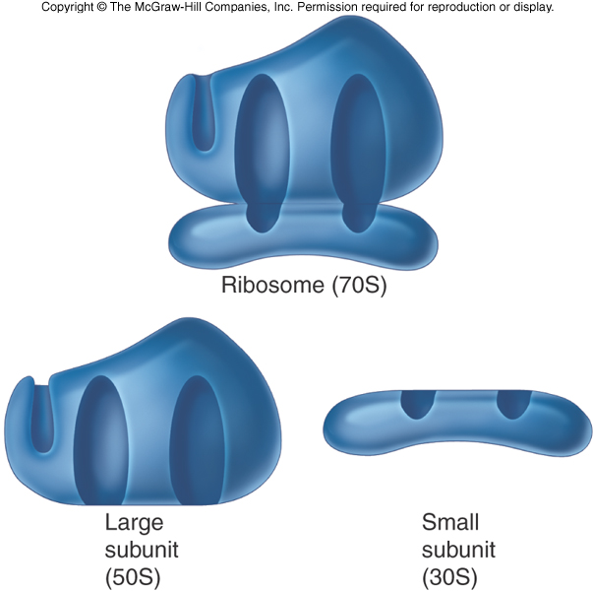
7

Slide 8
3. Mesosomes ( mostly in Gram +ve)
A large invaginations of the plasma membrane, irregular in shape.
a. increase in membrane surface, which may be useful as a site for enzyme activity in respiration and transport.
b. may participate in cell replication by serving as a place of attachment for the bacterial chromosome.

Slide 9
4. Inclusions
Not separate by a membrane but distinct.
Granules of various kinds:
* glycogen ( used as carbon source),
*polyhydroxybutyric acid droplets (PHB)
i.e. fat droplets and have Lipid inclusion
* inorganic metaphosphate (metachromatic granules or Volutin granules) - in general, starvation of cell for almost any nutrients leads to the formation of this to serve as an intracellular phosphate reservoir ( Corynebacterium).

Slide 10
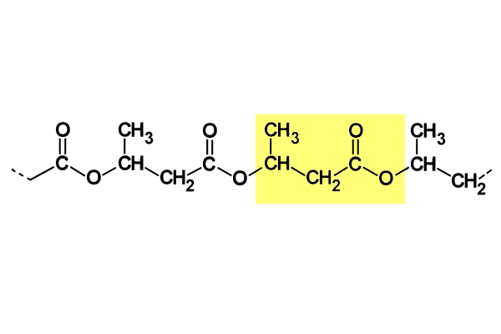
PHB

Slide 11
_{5. Chromatophores}
Only in photosynthetic bacteria and blue green algae. Prok. no chloroplast, pigment found in lamellae located beneath the cell membrane.
Sulfur Granules: Mainly in Thiobacillus, convert H2S to S

Slide 12
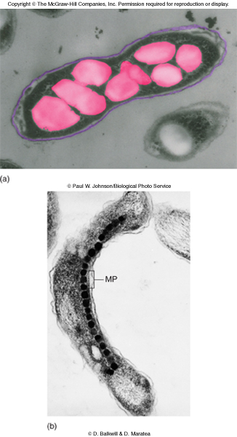
12

Slide 13
Special Structure: ENDOSPORE
An endospore is a dormant, tough, and non-reproductive structure produced by some bacteria in the phylum Firmicutes.
The name "endospore" is suggestive of a spore or seed-like form (endo means within), but it is not a true spore (i.e., not an offspring).
Bacteria produce a single endospore internally.
The spore is sometimes surrounded by a thin covering known as the exosporium, which overlies the spore coat.
The spore coat, which acts like a sieve that excludes large toxic molecules like lysozyme, is resistant to many toxic molecules and may also contain enzymes that are involved in germination.

Slide 14
The arrangement of spore layers is as follows:
Exosporium
Spore coat
Spore cortex
Core wall
The position of the endospore differs among bacterial species and is useful in identification.
The main types within the cell are terminal, sub terminal, and centrally placed endospores.

Slide 15
Terminal endospores are seen at the poles of cells, whereas central endospores are more or less in the middle.
Subterminal endospores are those between these two extremes, usually seen far enough towards the poles but close enough to the center so as not to be considered either terminal or central.
Lateral endospores are seen occasionally.
Examples of bacteria having terminal endospores include Clostridium tetani, the pathogen that causes the disease tetanus.
Bacteria having a centrally placed endospore include Bacillus cereus. Sometimes the endospore can be so large the cell can be distended around the endospore. This is typical of Clostridium tetani.

Slide 16
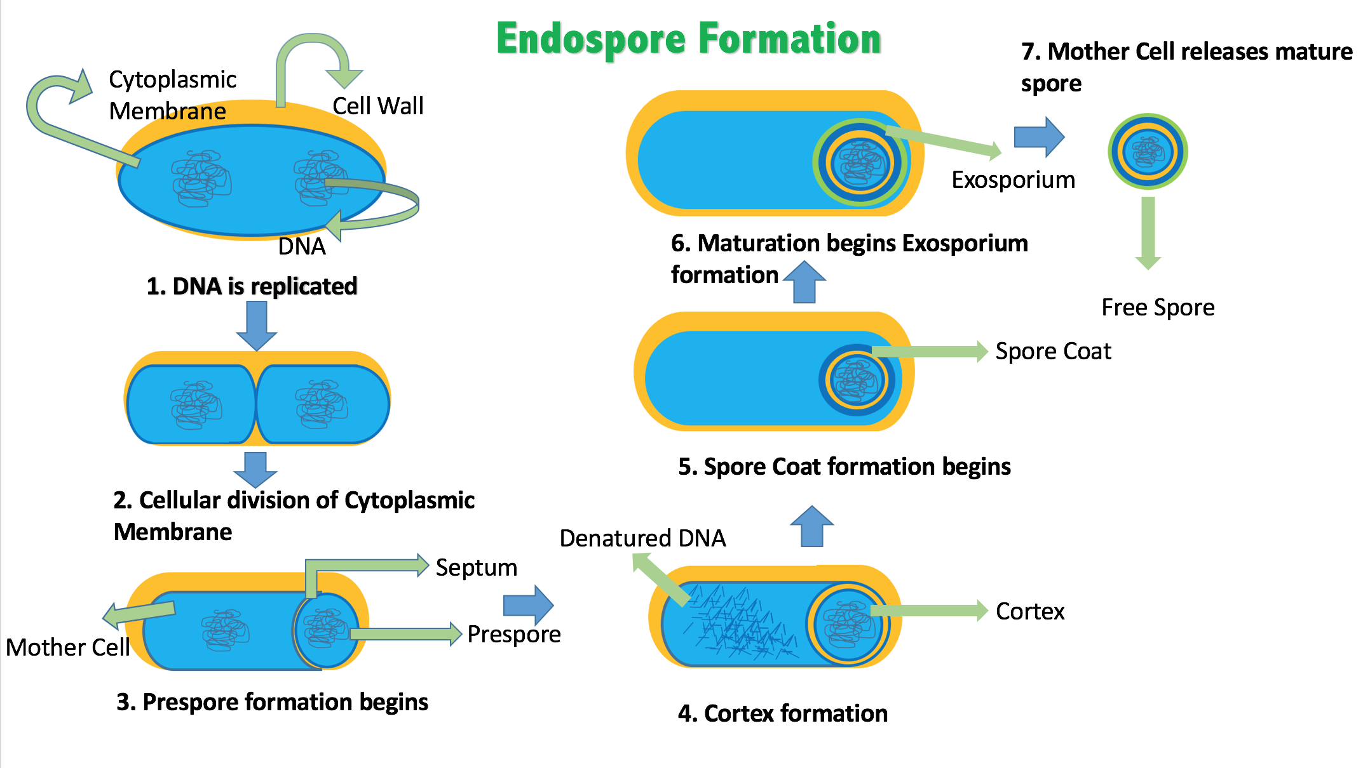

Slide 17
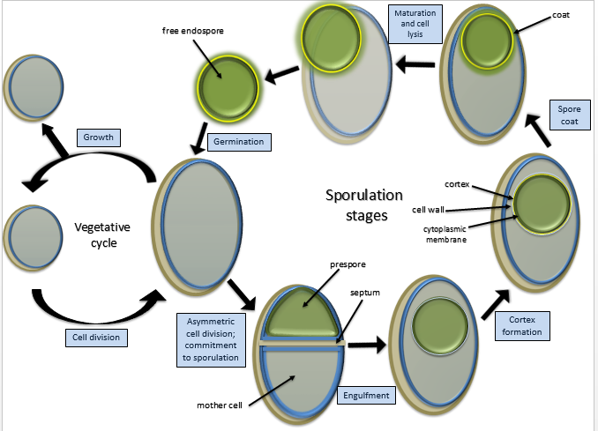

Slide 18
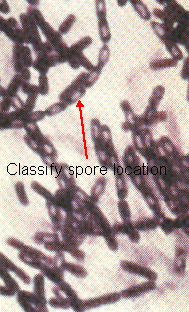

Slide 19
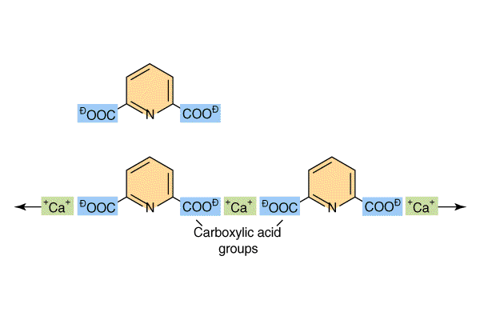
Dipicolinic acid

Slide 20
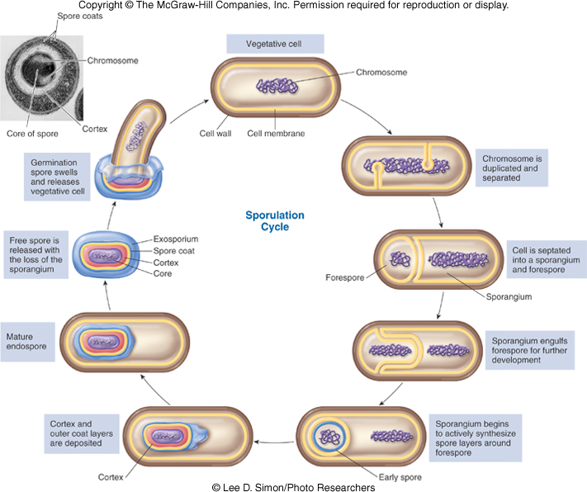
20

Slide 21
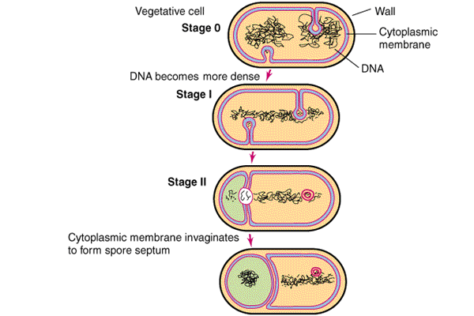
Detailed steps in endospore formation(1)

Slide 22
Detailed steps in endospore formation(2)

Slide 23
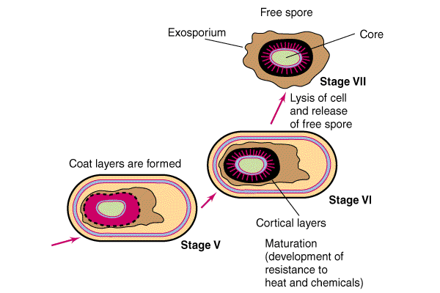
Detailed steps in endospore formation(3)

Slide 24
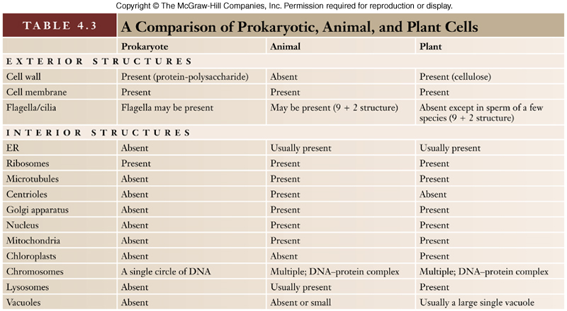

Slide 25
PROCARYOTIC vs. EUCARYOTIC CELLS

Slide 26
PROCARYOTIC vs. EUCARYOTIC CELLS

Slide 27
PROCARYOTIC vs. EUCARYOTIC CELLS

Slide 28
PROCARYOTIC vs. EUCARYOTIC CELLS

Slide 29
THANKS

